Slide 1
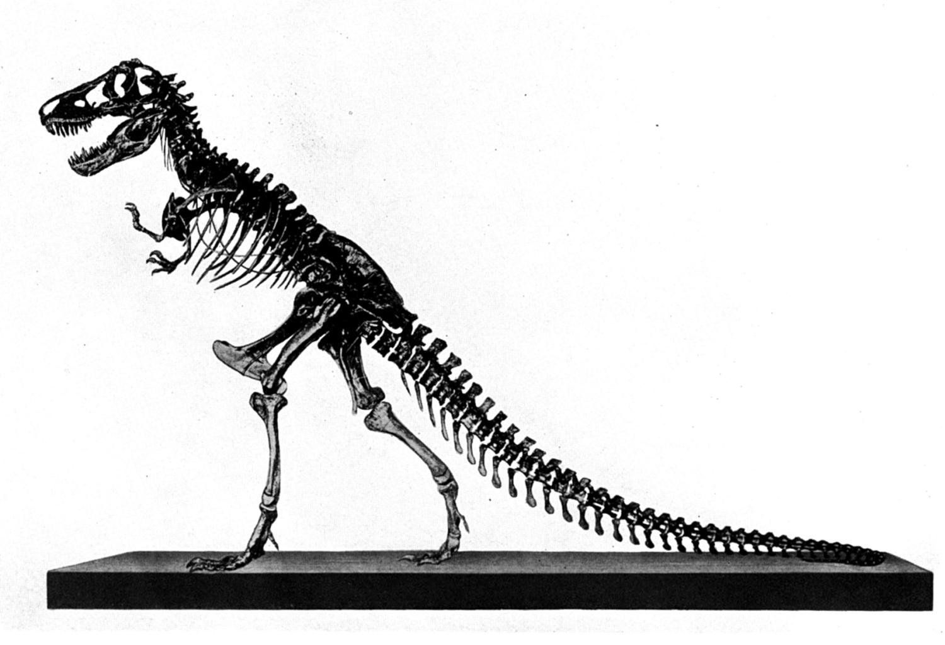
Behemoth &
Leviathan
Job 38:39 – 39:30
context
Part 2d

Slide 2
Previously:
Rebuked from a whirlwind for darkening counsel with words without knowledge (38:1-3)
Wanted answers but received questions

Slide 3
Review:
1 evidence for dinosaurs and man living together
2_{a} the conflict between Job and his friends and between Job and God
2_{b} Elihu’s response
2_{c} Jehovah’s 1st response (the inanimate world quiz, 38:1-38)
2_{d} Jehovah’s 1st response cont. (the world’s animated material quiz, 38:39-39:30)
concept
context
Today’s Lesson

Slide 4
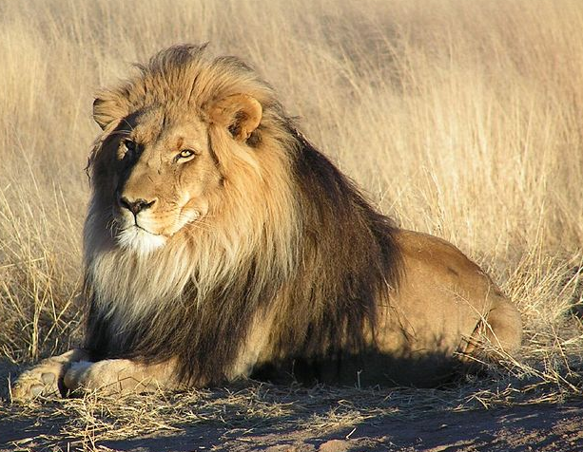
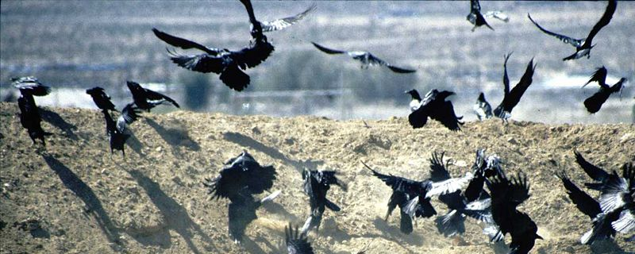
Lions and Ravens
(Job 38:39-41)
Animals governed by something other than physical laws
The instinct and appetite which God puts into animals…neither controlled nor contributed by man

Slide 5
Lions and Ravens
(Job 38:39-41)
God is good even to meat eating animals, both great and small, for the noble and contemptible!
Not a purely vegetarian world—God provides for all creatures but such doesn’t rule out death
Psalm 147:7-11

Slide 6
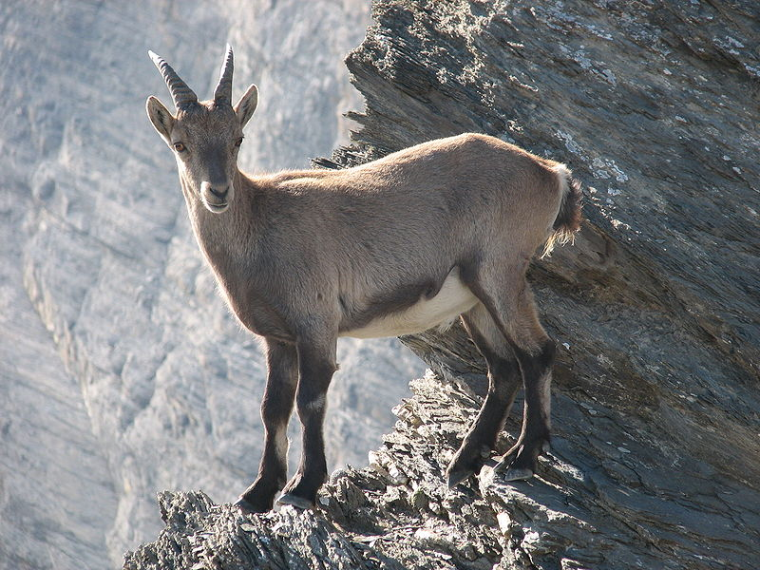
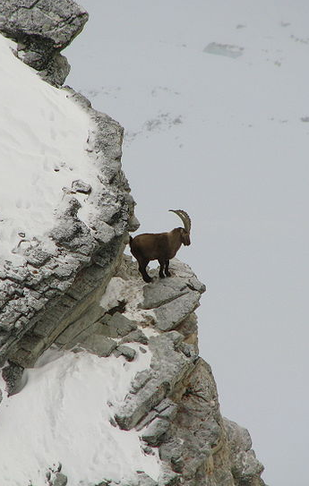
Wild Mountain Goats and Deer (Job 39:1-4)
Steinbock (Alpine ibex)
When do they bear?
No help from man to bring forth young
Young grow strong and leave their mother but are provided for by God

Slide 7
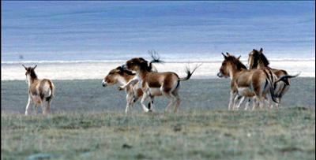
“Wild Donkey”
(Job 39:5-8)
Who sets free?
  Loves freedom, shuns civilization
  “Man can rob animals of freedom, but not, as God, give freedom, combined with subordination to fixed laws” (JFB)
God has made what is considered wild and barren his dwelling place
  He flourishes in desolate places
He scorns the tumult of the city
He does not heed the shouts of the “driver” (same word as “taskmasters, "see, Ex. 3:7).

Slide 8
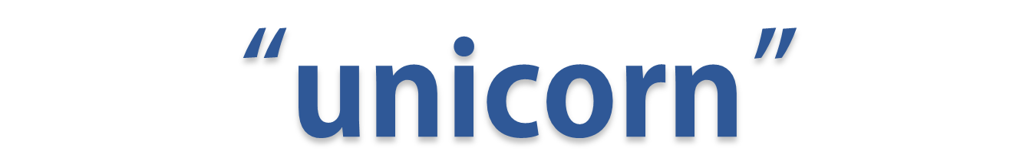
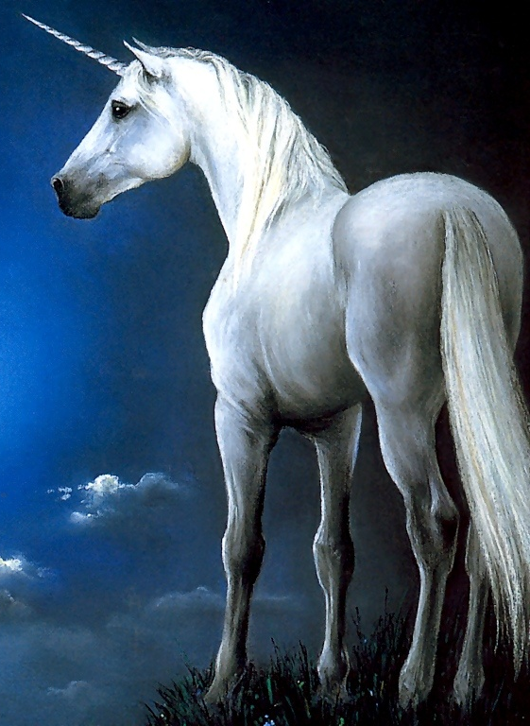
Re’em
9 "Will the wild ox be willing to serve you? Will he bed by your manger?
10 Can you bind the wild ox in the furrow with ropes? Or will he plow the valleys behind you?
11 Will you trust him because his strength is great? Or will you leave your labor to him?
12 Will you trust him to bring home your grain, And gather it to your threshing floor?
“unicorn” (KJV)
Strong’s #07214
NOT THIS

Slide 9
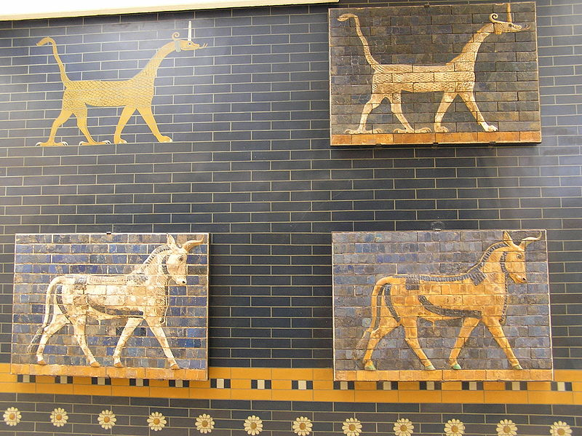
Wikimedia Commons

Slide 10
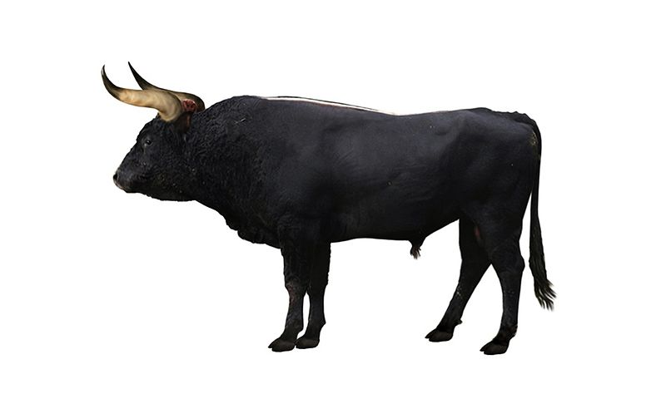
9 "Will the wild ox be willing to serve you? Will he bed by your manger?
10 Can you bind the wild ox in the furrow with ropes? Or will he plow the valleys behind you?
11 Will you trust him because his strength is great? Or will you leave your labor to him?
12 Will you trust him to bring home your grain, And gather it to your threshing floor?
“unicorn” (KJV)
Strong’s #07214
Aurochs (Bos primigenius)
LIKELY THIS!

Slide 11
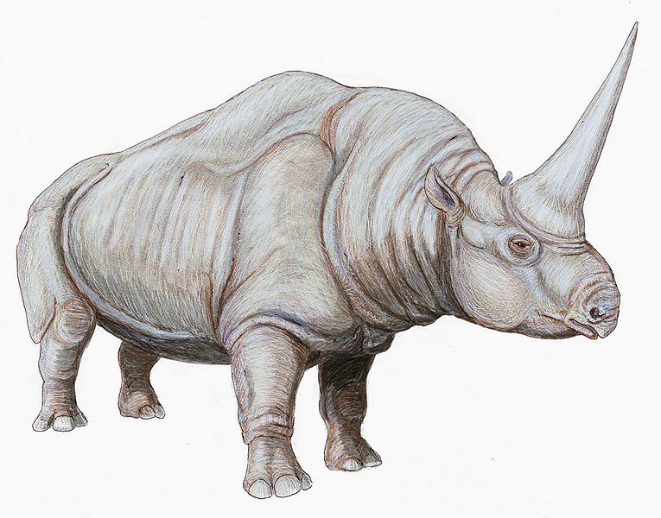
9 "Will the wild ox be willing to serve you? Will he bed by your manger?
10 Can you bind the wild ox in the furrow with ropes? Or will he plow the valleys behind you?
11 Will you trust him because his strength is great? Or will you leave your labor to him?
12 Will you trust him to bring home your grain, And gather it to your threshing floor?
“unicorn” (KJV)
Strong’s #07214
Elasmotherium caucasicum
OR THIS

Slide 12
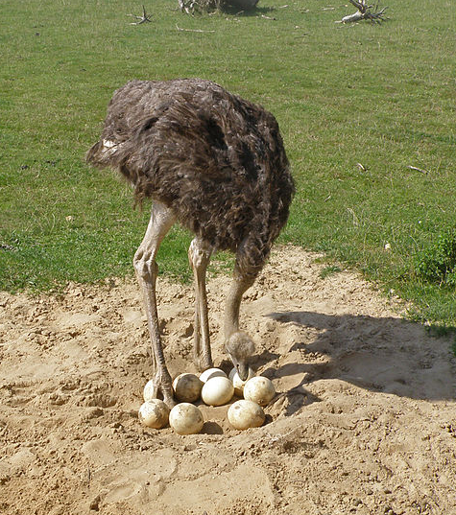
Other Animals
Ostrich (39:13-18) – leaves eggs, forgets of their easy destruction, treats young harshly, deprived of wisdom, yet scorns the horse and rider

Slide 13
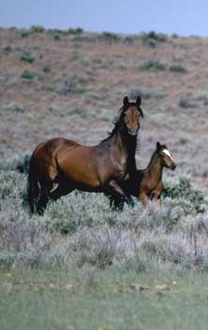
Other Animals
Horse (39:19-25) – strength, fearlessness, speed
Hawk and Eagle (39:26-30) – amazing flight and sight
Brought Job to silence but not to repentance (Job 40:1-5)!

Slide 14

Observations
Job held a complaint as to how the world was(Job 24)
  Filled with violence and wickedness
  A seemingly delay by God in the wicked being cut off
  A rebuke towards God (Job 40:2)
    Further revelation (Ezek. 33:11; 2 Pet. 3:9)

Slide 15

OBSERVATIONS
The way the world is, is the way it is
The way it is, is not the way it originally was
  Dominion was originally charged and granted to man (Gen. 1:26-28)
  A “wildness” of fear and dread has filled the animal kingdom (Gen. 9:2, 3)
  The carnivorous appetite necessarily implies that in God’s provisions to this world, pain, hardship, and death are consistent components of it (Job. 38:39; 39:15, 29, 30)
  Man cannot control or provide for many kinds of animals (the lion, the raven, the wild goat, the wild donkey, the wild oxen) –yet God does!

Slide 16
OBSERVATIONS
The way the world is, is the way it is
The way it is, is not the way it originally was
  Sin changed everything—man falls below what he is to reign over (Gen. 3:17-19)
  “Wild” animals underscores what death itself teaches– that man is not in control of his world
  Does not mean that God has lost control
  Man must trust and obey God’s provisions, even in trial, lest he be as unproductive and foolish as wild animals
  The hardship of this world is seen in everything, yet it can be a means of saving man, and is not designed for his ultimate demise (Job 33:14-30)

